Slide 1

Typescript
Source: Tutorialpoint

Slide 2
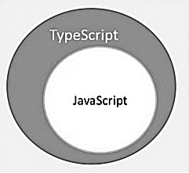
What is Typescript?
“TypeScript is JavaScript for application-scale development.”
TypeScript is a strongly typed, object oriented, compiled language. It was designed by Anders Hejlsberg (designer of C#) at Microsoft. TypeScript is both a language and a set of tools. TypeScript is a typed superset of JavaScript compiled to JavaScript. In other words, TypeScript is JavaScript plus some additional features.

Slide 3
Features of TypeScript
TypeScript is just JavaScript. TypeScript starts with JavaScript and ends with JavaScript. Typescript adopts the basic building blocks of your program from JavaScript. Hence, you only need to know JavaScript to use TypeScript. All TypeScript code is converted into its JavaScript equivalent for the purpose of execution.
TypeScript supports other JS libraries. Compiled TypeScript can be consumed from any JavaScript code. TypeScript-generated JavaScript can reuse all of the existing JavaScript frameworks, tools, and libraries.
JavaScript is TypeScript. This means that any valid .js file can be renamed to .ts and compiled with other TypeScript files.
TypeScript is portable. TypeScript is portable across browsers, devices, and operating systems. It can run on any environment that JavaScript runs on. Unlike its counterparts, TypeScript doesn’t need a dedicated VM or a specific runtime environment to execute.

Slide 4
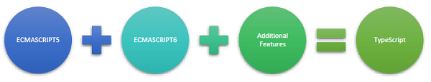
TypeScript and ECMAScript
The ECMAScript specification is a standardized specification of a scripting language. There are six editions of ECMA-262 published. Version 6 of the standard is codenamed "Harmony". TypeScript is aligned with the ECMAScript6 specification.
TypeScript adopts its basic language features from the ECMAScript5 specification, i.e., the official specification for JavaScript. TypeScript language features like Modules and class-based orientation are in line with the EcmaScript 6 specification. Additionally, TypeScript also embraces features like generics and type annotations that aren’t a part of the EcmaScript6 specification.

Slide 5

benefits of TypeScript
Compilation − JavaScript is an interpreted language. Hence, it needs to be run to test that it is valid. It means you write all the codes just to find no output, in case there is an error. Hence, you have to spend hours trying to find bugs in the code. The TypeScript transpiler provides the error-checking feature. TypeScript will compile the code and generate compilation errors, if it finds some sort of syntax errors. This helps to highlight errors before the script is run.
Strong Static Typing − JavaScript is not strongly typed. TypeScript comes with an optional static typing and type inference system through the TLS (TypeScript Language Service). The type of a variable, declared with no type, may be inferred by the TLS based on its value.
TypeScript supports type definitions for existing JavaScript libraries. TypeScript Definition file (with .d.ts extension) provides definition for external JavaScript libraries. Hence, TypeScript code can contain these libraries.
TypeScript supports Object Oriented Programming concepts like classes, interfaces, inheritance, etc.

Slide 6
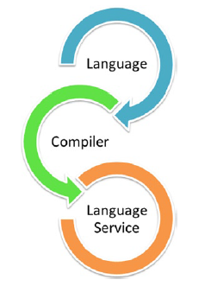
Components of TypeScript
At its heart, TypeScript has the following three components −
Language − It comprises of the syntax, keywords, and type annotations.
The TypeScript Compiler − The TypeScript compiler (tsc) converts the instructions written in TypeScript to its JavaScript equivalent.
The TypeScript Language Service − The "Language Service" exposes an additional layer around the core compiler pipeline that are editor-like applications. The language service supports the common set of a typical editor operations like statement completions, signature help, code formatting and outlining, colorization, etc.

Slide 7
Declaration Files
When a TypeScript script gets compiled, there is an option to generate a declaration file (with the extension .d.ts) that functions as an interface to the components in the compiled JavaScript. The concept of declaration files is analogous to the concept of header files found in C/C++. The declaration files (files with .d.ts extension) provide intellisense for types, function calls, and variable support for JavaScript libraries like jQuery, MooTools, etc.

Slide 8
TypeScript - Environment Setup
Test
Test online at www.typescriptlang.org/Playground
Install
Install NodeJs and then use npm to install TypeScript
npm install -g typescript
Install
Install NodeJs and then use npm to install TypeScript
Use
Use VisualStudio code or webstorm for IDE

Slide 9
TypeScript - Basic Syntax
Syntax defines a set of rules for writing programs. Every language specification defines its own syntax. A TypeScript program is composed of −
Modules
Functions
Variables
Statements and Expressions
Comments

Slide 10
First Program
var message:string = "Hello World"
console.log(message)
Save and Run tsc Hello.ts and it will generate:
var message = "Hello World";
console.log(message);

Slide 11
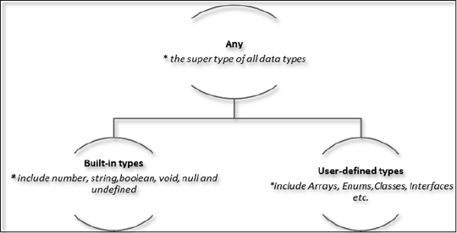
TypeScript - Types
The Type System represents the different types of values supported by the language. The Type System checks the validity of the supplied values, before they are stored or manipulated by the program. This ensures that the code behaves as expected. TypeScript provides data types as a part of its optional Type System. The data type classification is as given below −

Slide 12
TypeScript - Variables
A variable, by definition, is “a named space in the memory” that stores values. In other words, it acts as a container for values in a program. TypeScript variables must follow the JavaScript naming rules −
Variable names can contain alphabets and numeric digits.
They cannot contain spaces and special characters, except the underscore (_) and the dollar ($) sign.
Variable names cannot begin with a digit.
Examples:
var name:string = "John";
var score1:number = 50;
var score2:number = 42.50
var sum = score1 + score2

Slide 13
TypeScript - Operators
TypeScript Supports:
Arithmetic Operators
Relational Operators
Logical Operators
Bitwise Operators
Assignment Operators
Negation operator
String Operators
Conditional Operator
typeof operator
instanceof

Slide 14
TypeScript - Decision Making
Statement & Description
if statement An ‘if’ statement consists of a Boolean expression followed by one or more statements.
if...else statement An ‘if’ statement can be followed by an optional ‘else’ statement, which executes when the Boolean expression is false.
else…if and nested if statements You can use one ‘if’ or ‘else if’ statement inside another ‘if’ or ‘else if’ statement(s).
switch statement A ‘switch’ statement allows a variable to be tested against a list of values.

Slide 15
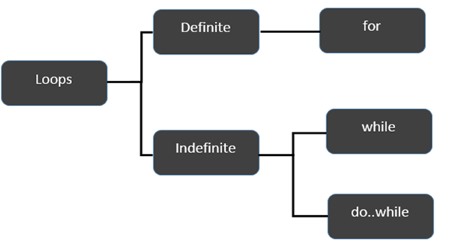
TypeScript - Loops
var n:number = 5
while(n > 5) {
console.log("Entered while")
}
do {
console.log("Entered do…while")
}
while(n>5)

Slide 16
TypeScript - Functions
A function is a set of statements to perform a specific task. Functions organize the program into logical blocks of code. Once defined, functions may be called to access code. This makes the code reusable.
function disp_details(id:number,name:string,mail_id?:string) {
console.log("ID:", id);
console.log("Name",name);
if(mail_id!=undefined)
console.log("Email Id",mail_id);
}
disp_details(123,"John");
disp_details(111,"mary","mary@xyz.com");

Slide 17
Typescript: number,String, Arrays
var var_name = new Number(value)
var var_name = new String(string);
function employee(id:number,name:string) {
this.id = id
this.name = name
}
var alphas:string[];
alphas = ["1","2","3","4"]

Slide 18
TypeScript – Tuples And union
At times, there might be a need to store a collection of values of varied types. Arrays will not serve this purpose. TypeScript gives us a data type called tuple that helps to achieve such a purpose.
var mytuple = [10,"Hello"];
Union types are a powerful way to express a value that can be one of the several types.
var val:string|number;
val = 12;
console.log("numeric value of val " + val);
val = "This is a string";
console.log("string value of val " + val);

Slide 19
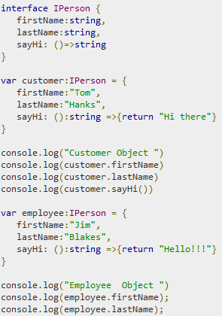
TypeScript - Interfaces
An interface is a syntactical contract that an entity should conform to. In other words, an interface defines the syntax that any entity must adhere to.
Interfaces define properties, methods, and events, which are the members of the interface. Interfaces contain only the declaration of the members. It is the responsibility of the deriving class to define the members. It often helps in providing a standard structure that the deriving classes would follow.

Slide 20
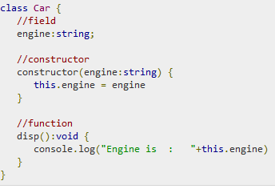
TypeScript - Classes
A class in terms of OOP is a blueprint for creating objects. A class encapsulates data for the object.
A constructor is a special function of the class that is responsible for initializing the variables of the class. TypeScript defines a constructor using the constructor keyword. A constructor is a function and hence can be parameterized.
The this keyword refers to the current instance of the class. Here, the parameter name and the name of the class’s field are the same. Hence to avoid ambiguity, the class’s field is prefixed with the this keyword.

Slide 21
TypeScript - Objects
An object is an instance which contains set of key value pairs. The values can be scalar values or functions or even array of other objects. The syntax is given below:
var person = {
firstName:"Tom",
lastName:“O’rourke",
sayHello:function() { } //Type template
}
person.sayHello = function() {
console.log("hello "+person.firstName)
}
person.sayHello()

Slide 22

TypeScript - Namespaces
A namespace is a way to logically group related code. This is inbuilt into TypeScript unlike in JavaScript where variables declarations go into a global scope and if multiple JavaScript files are used within same project there will be possibility of overwriting or misconstruing the same variables, which will lead to the “global namespace pollution problem” in JavaScript.
Defining a Namespace
A namespace definition begins with the keyword namespace followed by the namespace name as follows

Slide 23
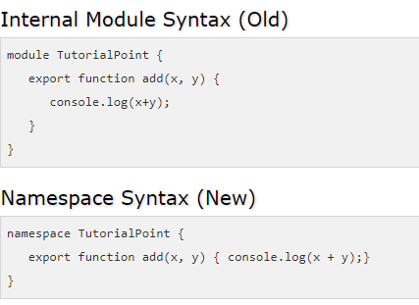
TypeScript - Modules
A module is designed with the idea to organize code written in TypeScript. Modules are broadly divided into −
Internal Modules - Internal modules came in earlier version of Typescript. This was used to logically group classes, interfaces, functions into one unit and can be exported in another module. This logical grouping is named namespace in latest version of TypeScript. So internal modules are obsolete instead we can use namespace. Internal modules are still supported, but its recommended to use namespace over internal modules.

Slide 24
TypeScript - Modules
External Module
External modules in TypeScript exists to specify and load dependencies between multiple external js files. If there is only one js file used, then external modules are not relevant. Traditionally dependency management between JavaScript files was done using browser script tags (<script></script>). But that’s not extendable, as its very linear while loading modules. That means instead of loading files one after other there is no asynchronous option to load modules. When you are programming js for the server for example NodeJs you don’t even have script tags.
There are two scenarios for loading dependents js files from a single main JavaScript file.
Client Side - RequireJs
Server Side - NodeJs
import someInterfaceRef = require(“./SomeInterface”);

